Slide 1
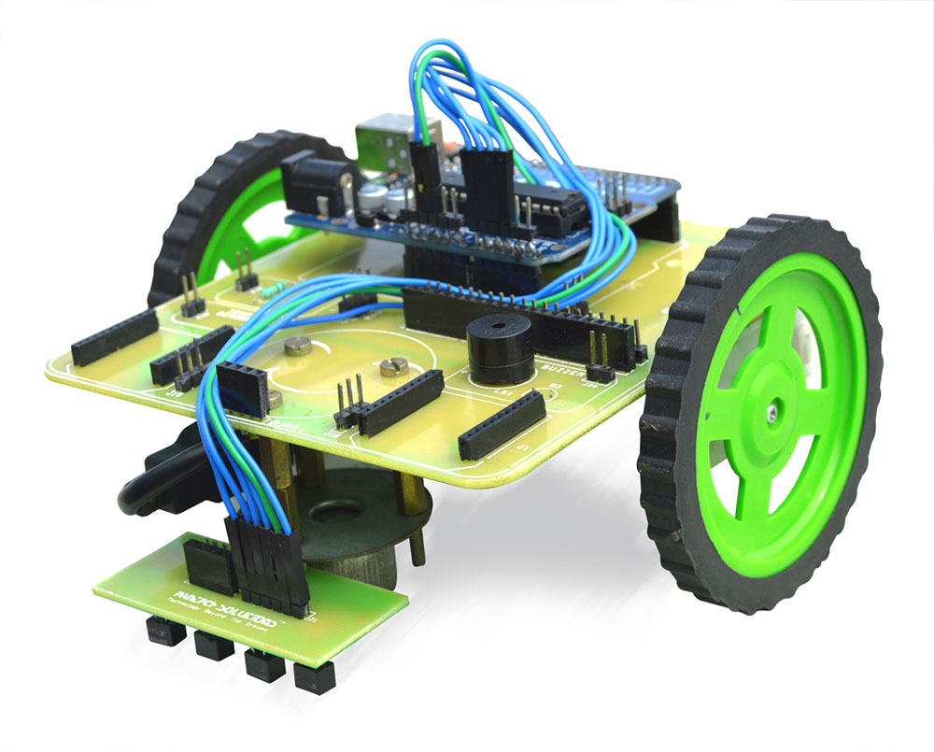
Line follower using 8051
Presented by:
19-20-05 satya teja
19-20-06 rohith
19-20-07 kamalesh
19-20-08 nikhil

Slide 2
content
Abstract
Introduction
Block Diagram
Circuit diagram
Components
Features
Applications
Advantages
Disadvantages

Slide 3
ABSTRACT
The Line follower robot is a basic robot which follows the line, it may be black or white line and having some particular width.
Line follower actually senses the line and run over it.
8051 microcontroller is the main component of project.
For sensing the line IR sensors are used.

Slide 4
introduction
The line follower robot mainly consist of 8051 microcontroller ,two IR sensors, motors and motor driver IC.
The line follower robot needs mechanical arrangement of chassis.
The two IR sensors are mounted on the front of the robot facing towards the earth.
IR sensor consist of IR transmitter and IR receiver on a board.
Thus depending on the output of IR sensor microcontroller indicates the motors to change their direction.

Slide 5
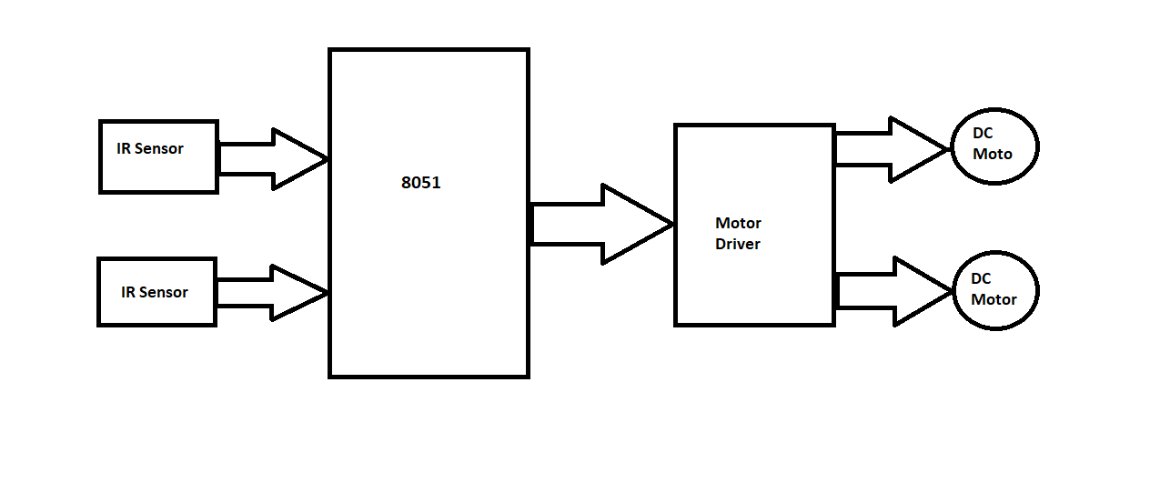
Block diagram

Slide 6
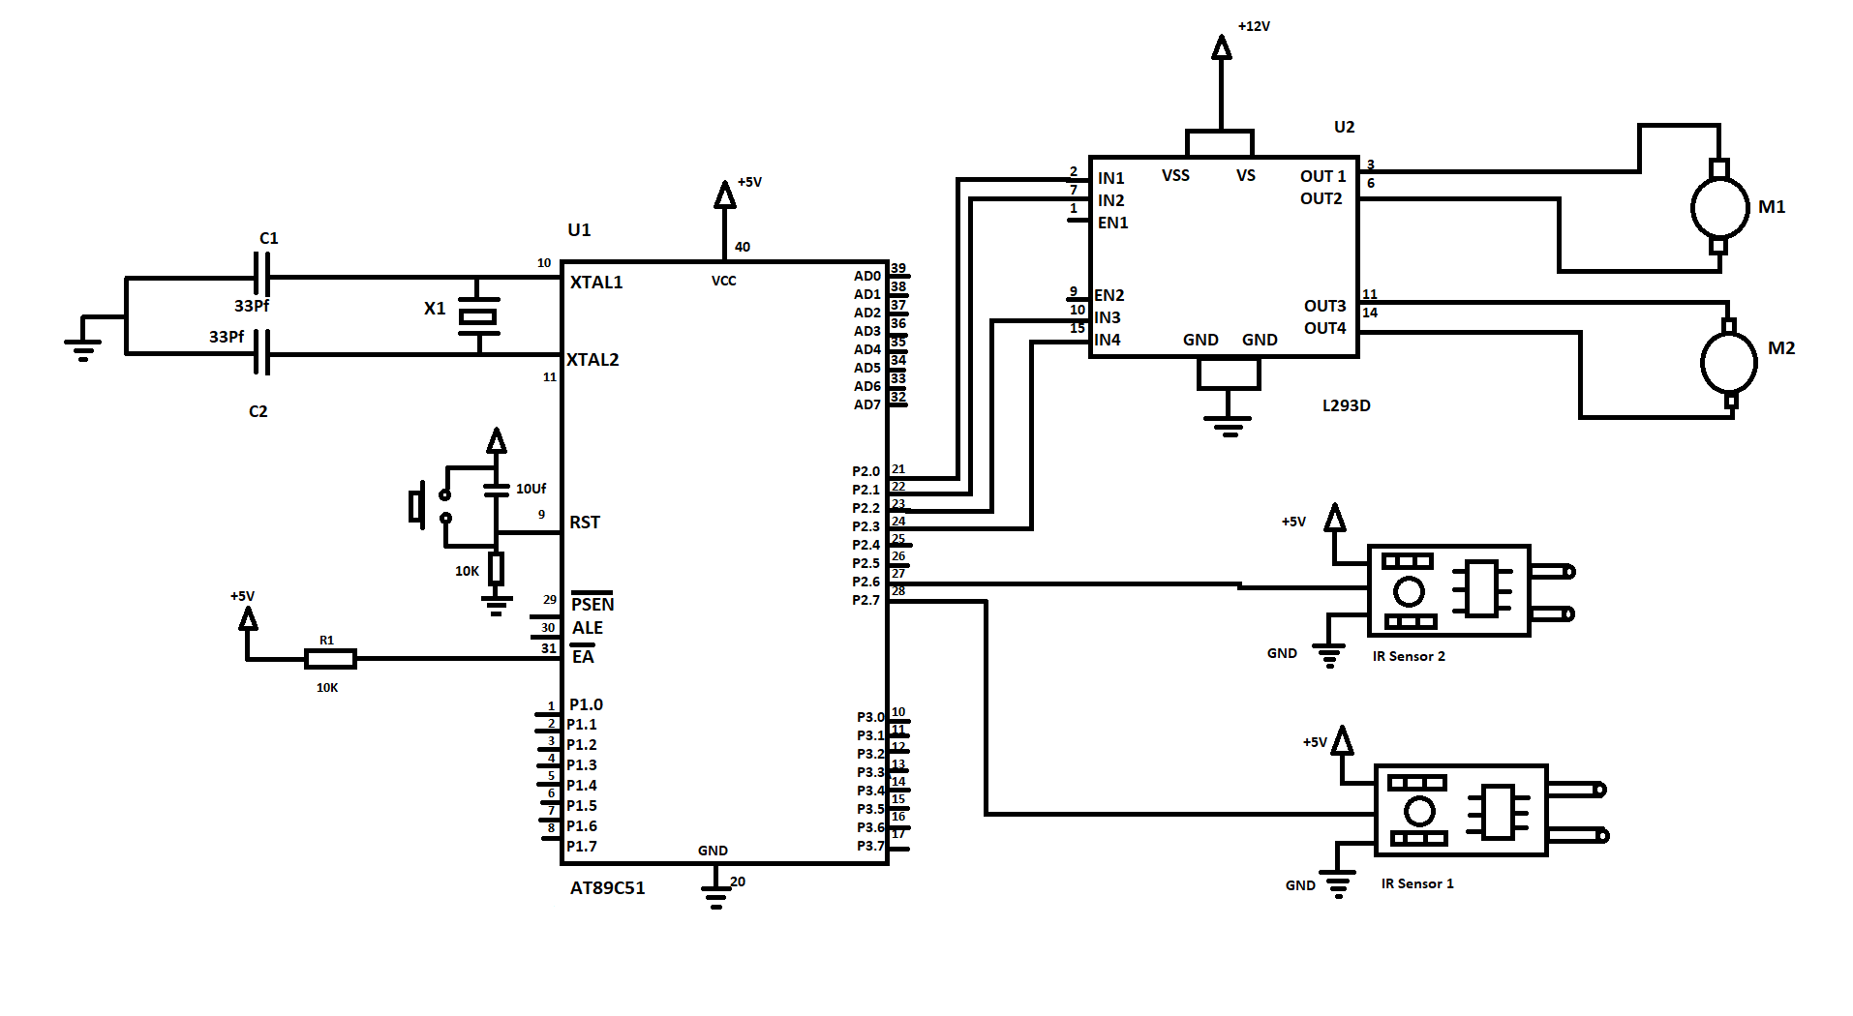
Circuit diagram

Slide 7
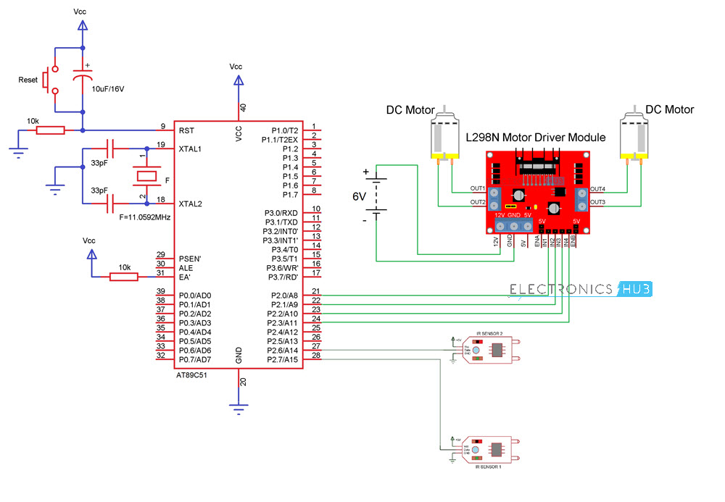
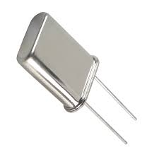
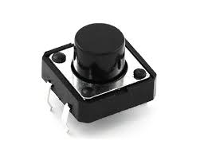

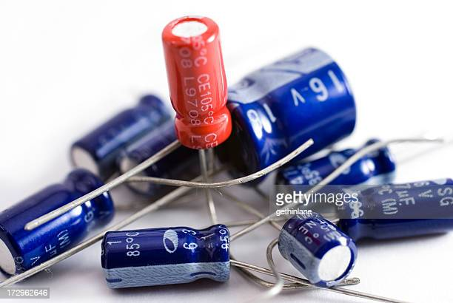
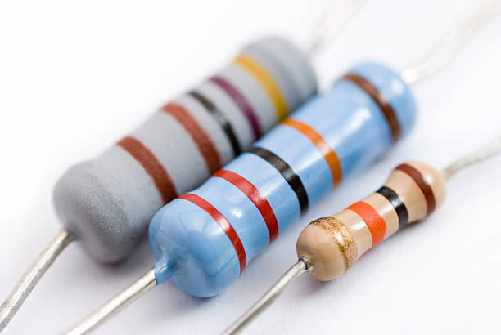
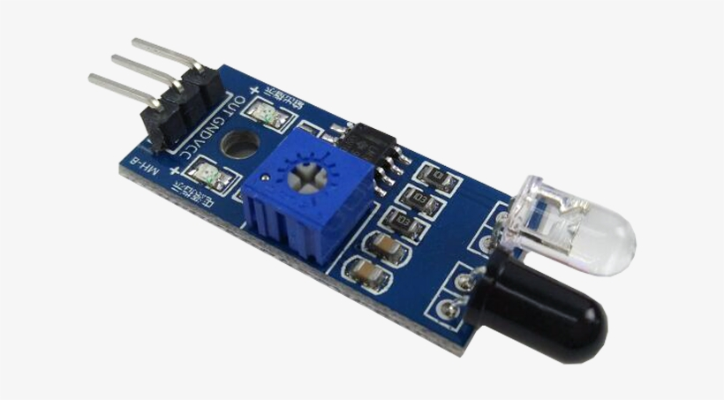
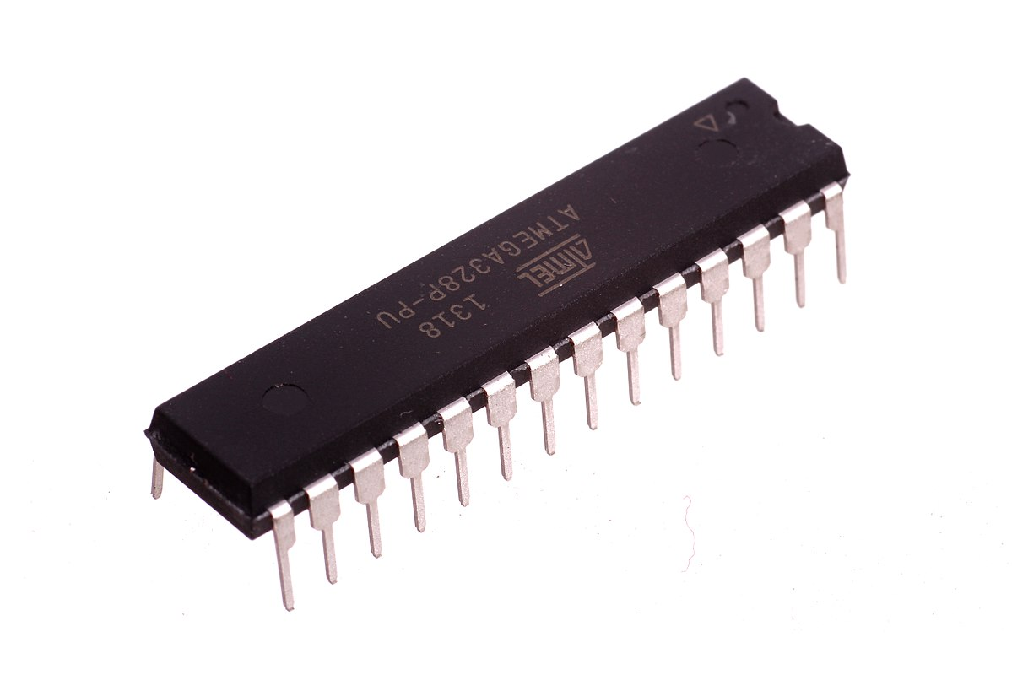
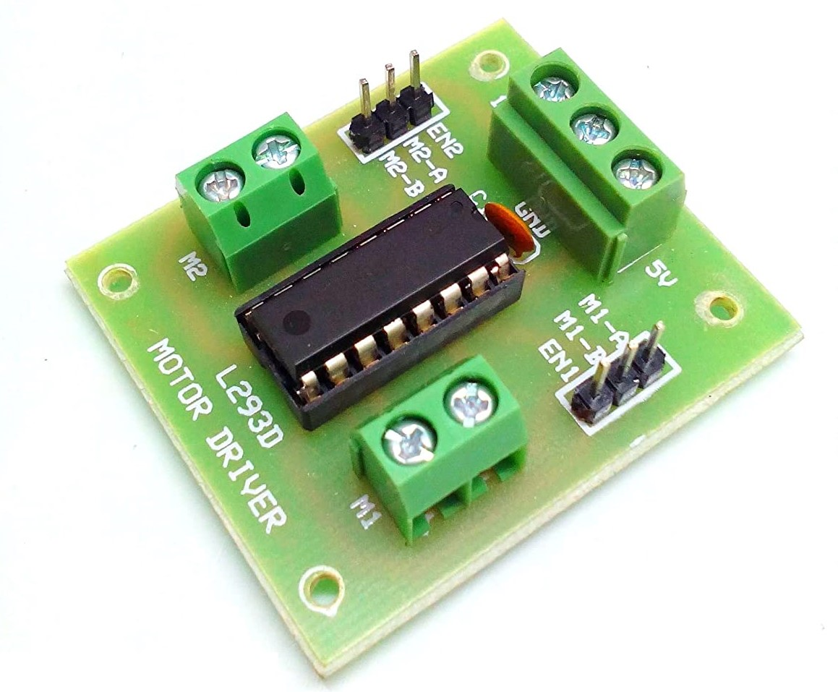

components
8051 microcontroller
IR Sensors - 2
10K Resistor - 2
33pF Capacitor - 2
11.0592 MHZ Crystal
Push button
Motor driver module (L293D)
2WD car Chassis with 2 wheels
Motors -2
Keil software
Proteus
EasyEDA

Slide 8
8051 MICROCONTROLLER
8051microcontroller is designed by intel in 1981.
It is an 8-bit microcontroller.
It is built with 40 pins, 4kb of ROM storage and 128 bytes of RAM storage, 2 16 bit timers.
It is generally used for transferring the data from central processing unit to memory.
Microcontroller is a compressed micro computer manufactured to control the functions of embedded system.

Slide 9
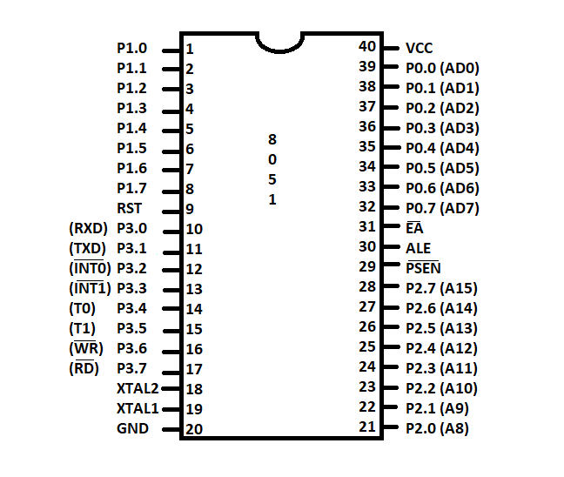
Pin diagram of 8051 microcontroller

Slide 10
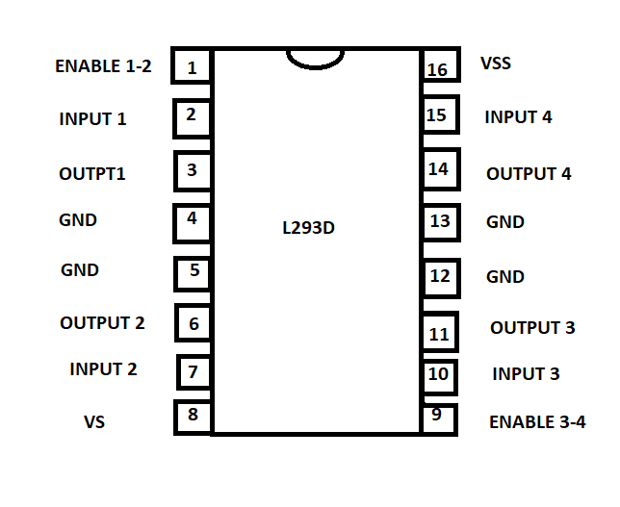
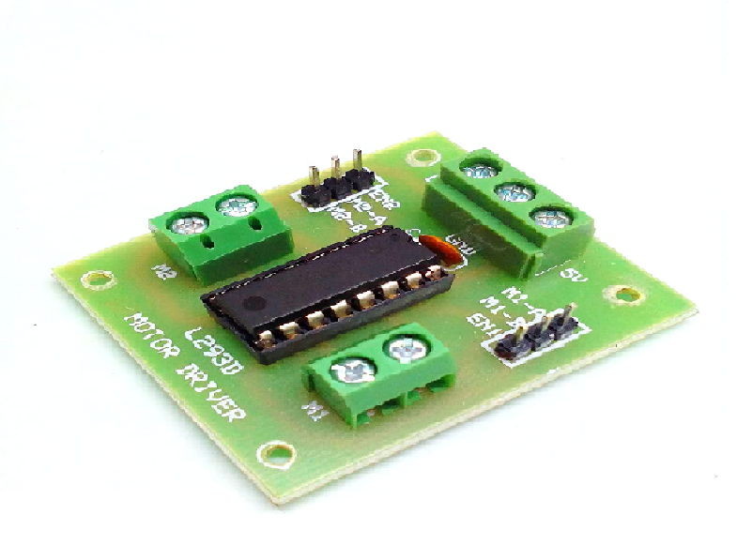
MOTOR DRIVER(L293D)
The L293D is designed to provide bidirectional drive current of up to 600mA at voltage from 4.5V to 36V.
Motor driver acts as an interface between the motors and the control circuits.
Motor requires high amount of current whereas the controller circuit works on low signals.

Slide 11
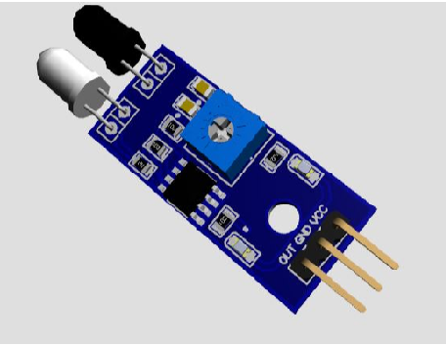
Ir sensor
An infrared sensor (IR sensor) is a radiation sensitive optoelectronic component.
An IR sensor can detect movement as well as to measure the heat of an object.
An IR sensor can detect infrared radiation, which is invisible to our eyes.

Slide 12
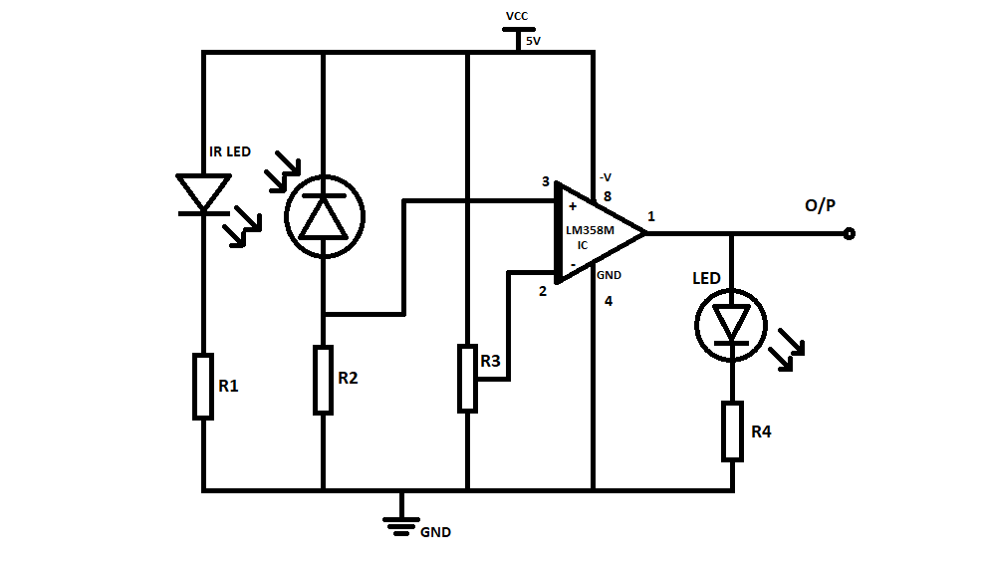
IR Sensor circuit diagram

Slide 13
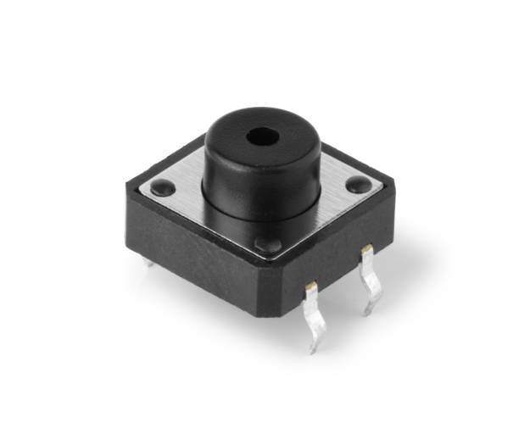
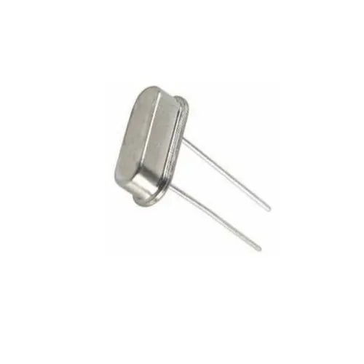
PUSH BUTTON
A Push button is a simple switch mechanism to control some aspect of a machine or a process.
CRYSTAL OSCILLATOR
A Crystal oscillator is an electric oscillator type circuit that uses a piezoelectric resonator, a crystal, as its frequency determining element.

Slide 14
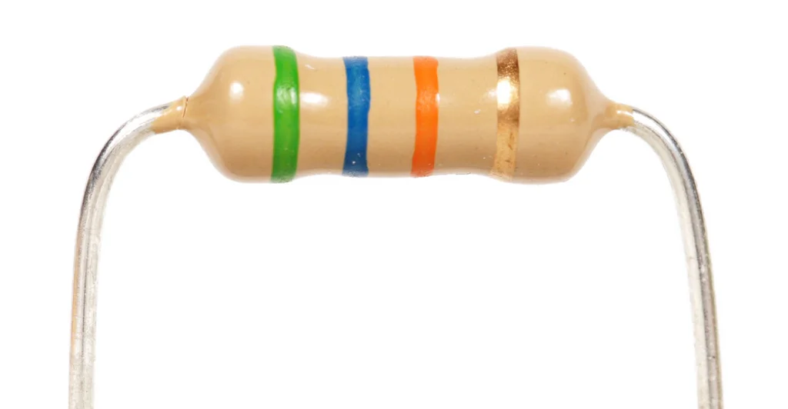
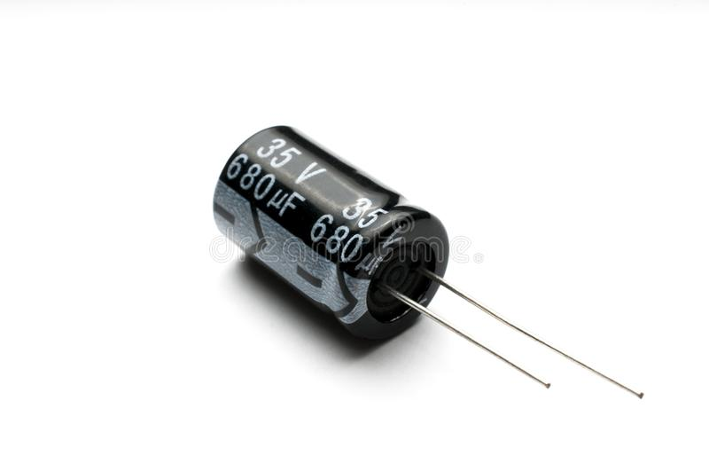
RESISTOR
A Resistor is a passive two terminal electrical component used to reduce current flow, adjust signal level.
CAPACITOR
A Capacitor is a two terminal electrical device that can store energy in the form of an electric charge.

Slide 15
KEIL MICRO VISION
The µVision IDE combines project management, run-time environment, build facilities, source code editing, and program debugging in a single powerful environment.
PROTEUS
The Proteus Design Suite is a proprietary software tool suite used primarily for electronic design automation.
Easy EDA
EasyEDA is an easier and powerful online PCB design tool that allows electronics engineers, educators, students, makers, and enthusiasts to design and share their projects.

Slide 16
features of line follower using 8051
Detecting and following the line drawn on the floor.
To help the robot navigate along a marked path, or in any other application involving discerning the boundary between two high contrast.
These robots can be used as automated equipment carriers in industries replacing traditional conveyer belts.
These can be used in public places like shopping malls, museums, industries etc. to provide path guidance.

Slide 17
ADVANTAGES
Robot movement is automatic.
It is used for long distance applications.
Simplicity of building.
Fit and forget system.
DISADVANTAGES
Line follower robot requires 2-3 inches broad line.
It may not move properly if the black line drawn is of low intensity.
The IR sensors may sometimes absorb IR rays from surrounding also. As a result, robot may move in improper way.

Slide 18
applications
These robots can be used as automated equipment carriers in industries replacing traditional conveyor belts.
These can also be used in industrial and defense applications.
These can be used in public places like shopping malls, industries, museums etc. to provide path guidance.

Slide 19
conclusion
The line follower robot works successfully to track on the black line. Above the white surface (art paper) there are some black lines in different directions. The robot still good enough to sense the line and follows the track. Also the robot is capable to carry some load likely 500gm.

Slide 20
Thank you

